Slide 1


Caspian Sea States Virtual Technomart
A Proposal
Guilan Science and Technology park (GSTP)

Slide 2
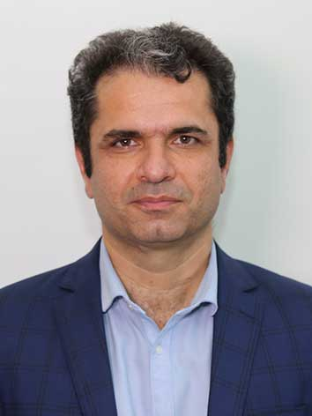
Presented by:
Dr. Ali Basti
President of Guilan Science and Technology Park
Secretary General of the Inter-Islamic Network on Science and Technology Parks (INSTP)
Executive Secretary of Technological Achievements and Techmart Exhibition
Guilan Science and Technology park (GSTP)

Slide 3

Globalization and Technology
Notes:
We live in an era of diverse application of modern technologies in all aspects, and science and technology has become an undisputable element of development in any country. Science and technology are vital to the competitiveness of any country in today’s globalized economy.
Coupled with globalization is the growing interdependency of countries on each other with a variety of opportunities, challenges and threats, which affects countries both individually and collectively.

Slide 4






What is Technomart?
Guilan Science and Technology park (GSTP)
Technology Transfer
Intellectual Property services
Investment Opportunities
Matchmaking and Networking
Commercialization
Notes:
The Technomart is a comprehensive and integrated market that facilitates technology transfer and commercialization between technology suppliers and clients. In other word, it is a systematic technology trade that provides intellectual property services, investment opportunities and matchmaking and networking.
Furthermore, technical and expertise services such as technology consultancy, information services, technologies and products feasibility studies, R & D market makers, development of technology capability and others are provided by the Technomart.

Slide 5
Technomart Processes
Guilan Science and Technology park (GSTP)

Slide 6
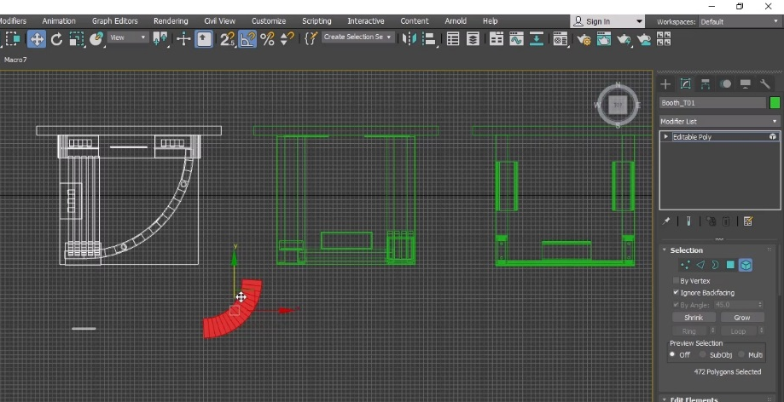
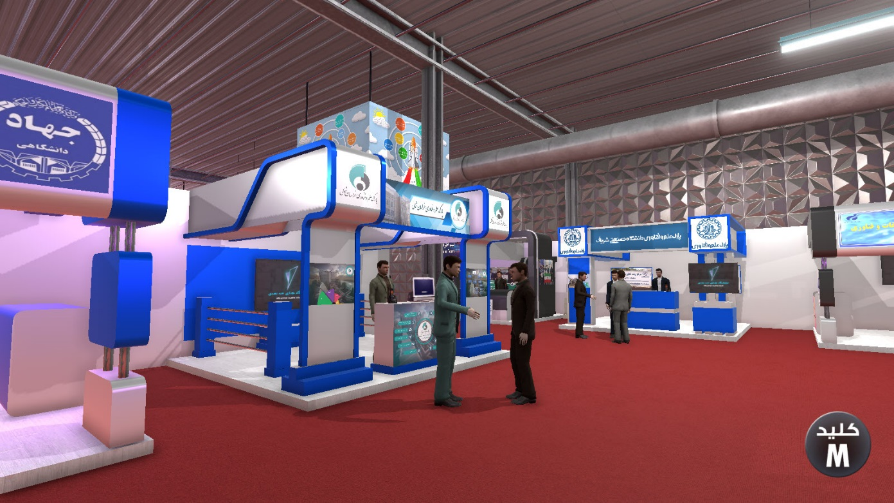
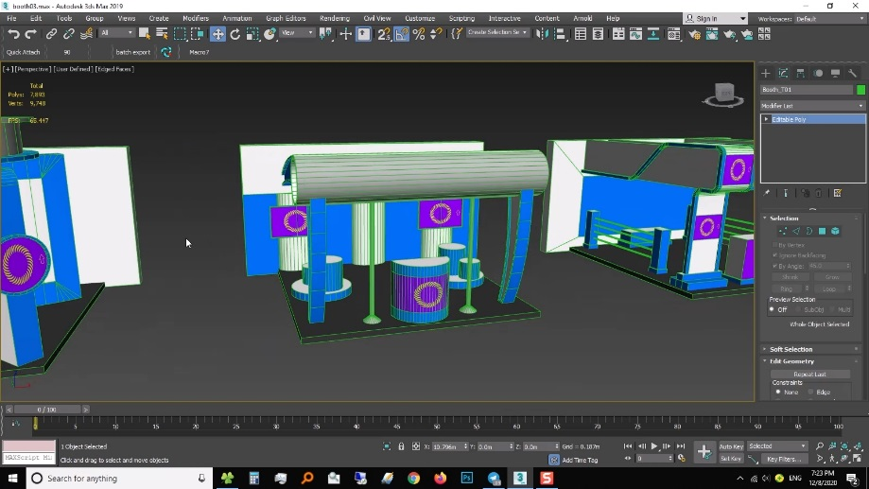
Iranian Technomart Design
Guilan Science and Technology park (GSTP)
Notes:
The virtual aspect of the Technomart was pushed forward as a result of the Covid-19 outbreak, and the need to establish an efficient replacement for the physical Technomart. As such, GSTP has had remarkable success in designing and applying the Virtual Technomart platform in Iran as well as the Guilan Province.

Slide 7
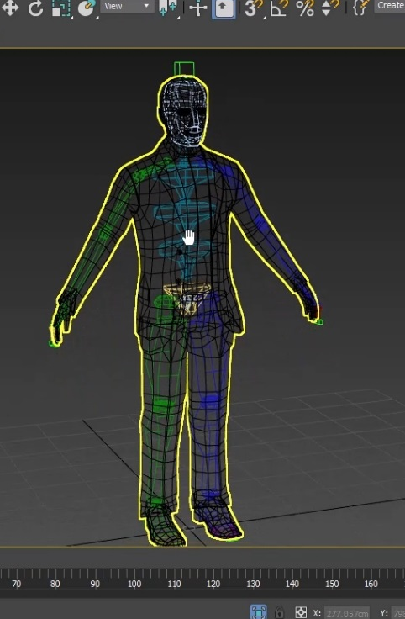
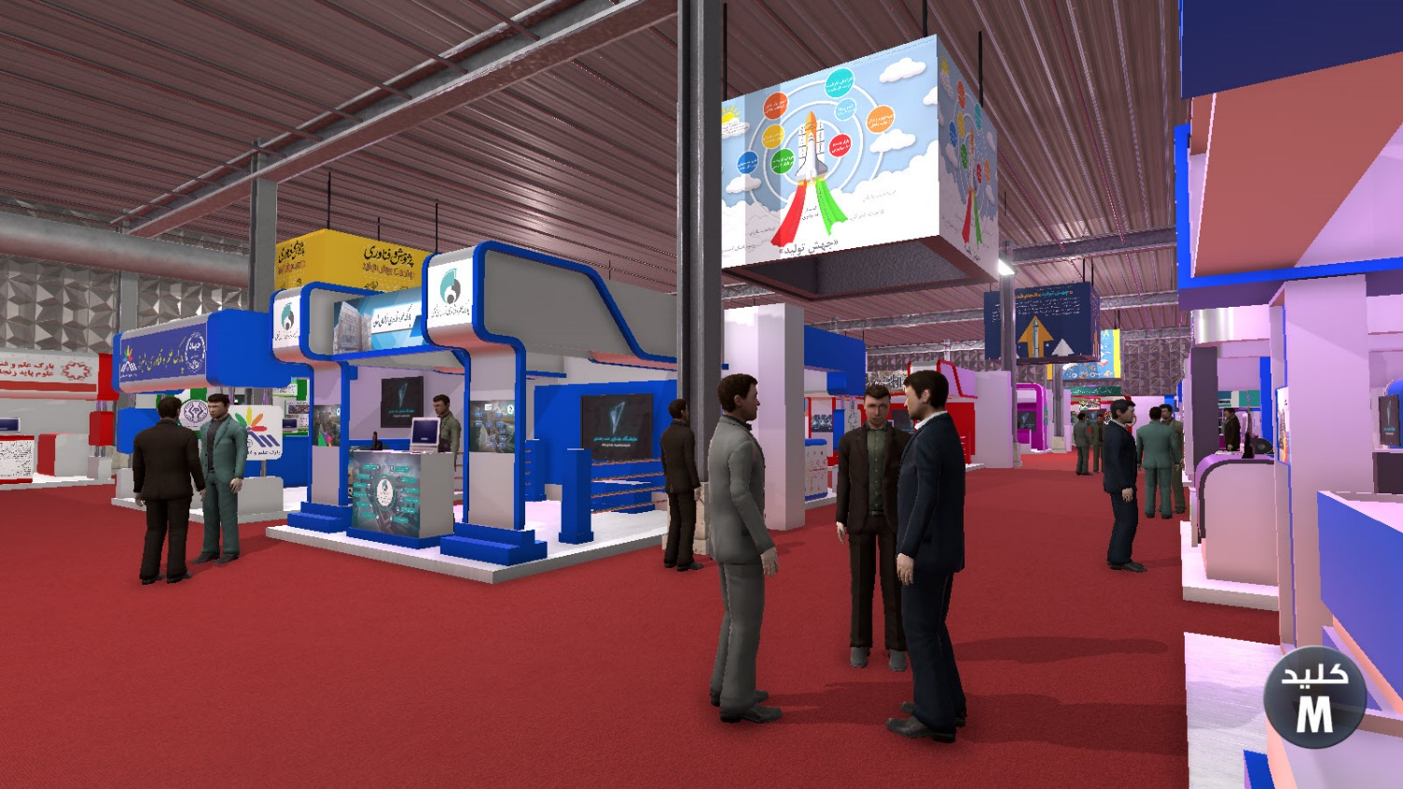
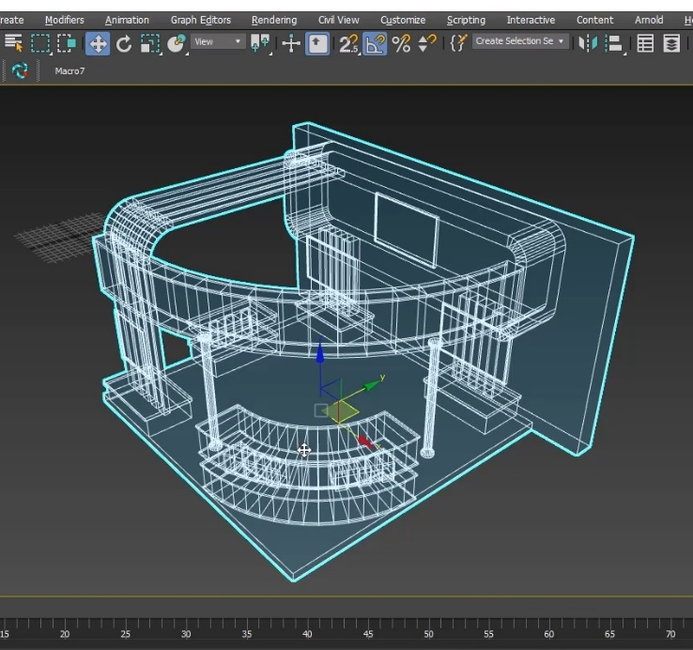
Iranian Technomart Design
Guilan Science and Technology park (GSTP)

Slide 8
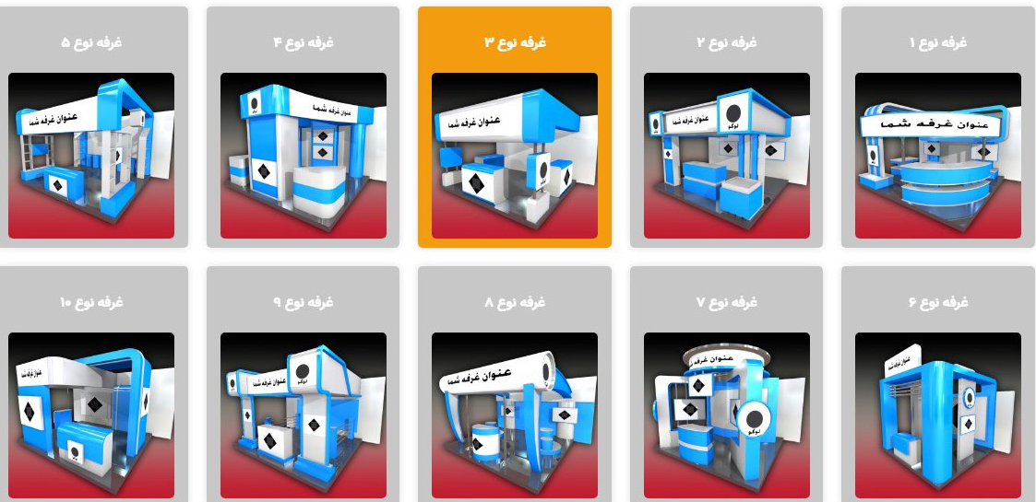
Booth Design Selection
Guilan Science and Technology park (GSTP)

Slide 9
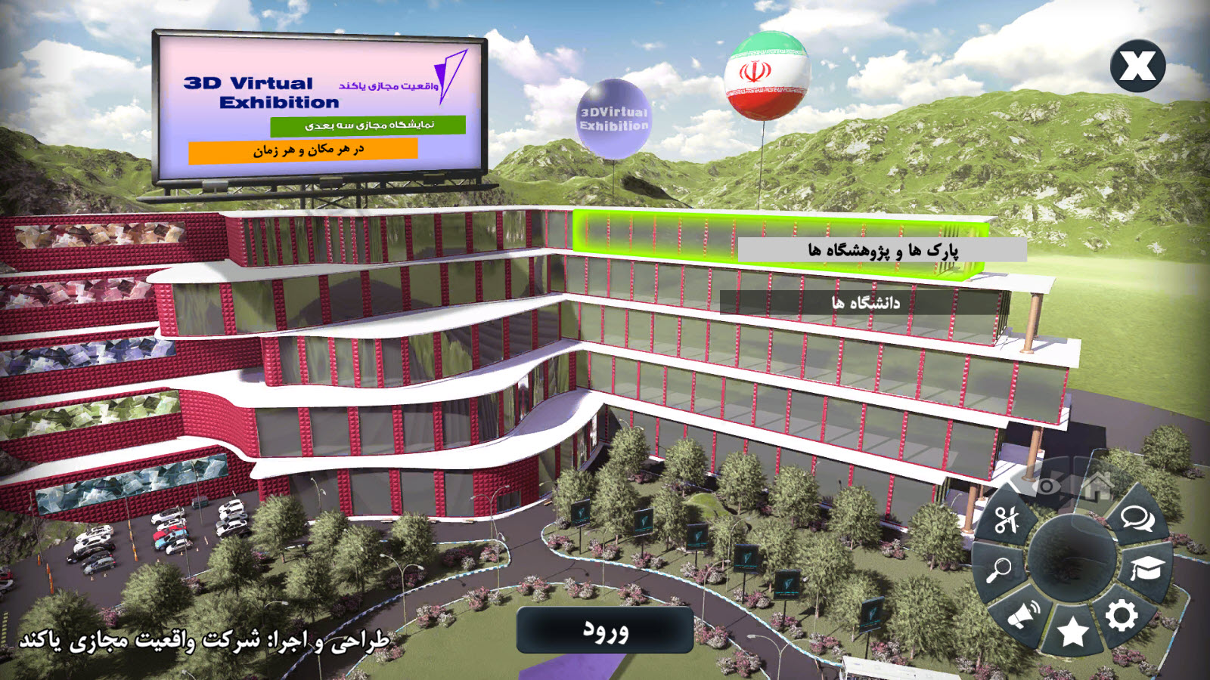
Iranian Virtual Technomart Design

Slide 10
Suggestions
With respect to the expertise that GSTP has as the organizer of the Iranian Techmart Exhibition for nine consecutive years as well as launching the virtual Techmart, GSTP would like to announce its readiness to provide and launch the platform of the Caspian Sea States Virtual Technomart.
This project is proposed to be carried out by GSTP jointly in partnership with the Commission for Science, Research and Technology.
Guilan Science and Technology park (GSTP)

Slide 11




Thank you for your attention!
Guilan Science and Technology park (GSTP)
www.GSTP.ir
basti@gstp.ir
@ali.basti
+98 13 3346 1550

